Slide 1
Lessons Learned from RAISE-ETP
John M. Kane, M.D.
Professor and Chairman Department of Psychiatry,
Hofstra Northwell School of Medicine
The Zucker Hillside Hospital

Slide 2
John M. Kane Disclosures 2017
Dr. Kane has been a consult for or received honoraria from Alkermes, Forum, Allergan, Genentech, H. Lundbeck, Intracellular Therapies, Janssen Pharmaceutica, Johnson & Johnson, Neurocrine, Otsuka, Pierre Fabre, Reviva, Roche, Sunovion, Takeda and Teva
Dr. Kane has received grant support from Otsuka and Janssen
Dr. Kane is a Shareholder in MedAvante, Inc., Vanguard Research Group and LB Pharmaceuticals, Inc.

Slide 3
Mean Duration of Untreated Psychosis
Meta-analyses:
Marshall 2005 = 124 wk
Menezes 2006 = 73.6 wk
Weeks
Marshall M et al. Arch Gen Psych. 2005;62:975; Menezes NM et al. Psychol Med. 2006;36:1349
Notes:
Marshall 2005 – 124 weeks
Menezes 2006 – 73.6 weeks

Slide 4
Implications of Delayed Treatment
Greater decrease in functioning
Loss of educational opportunities
Impaired psychosocial and vocational development
Personal suffering/family burdens
Potential poorer response once treatment is provided
Greater costs

Slide 5
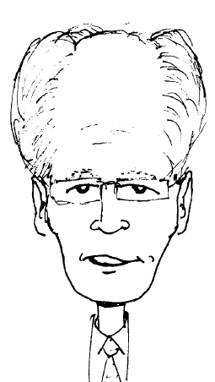
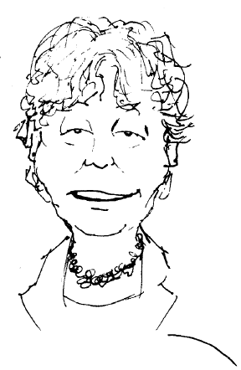
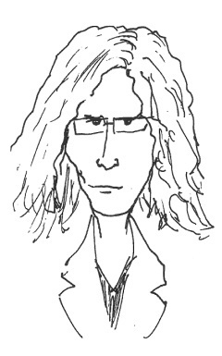
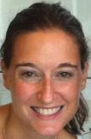
RAISE-ETP: Executive Committee
John Kane – Principle Investigator | The Zucker Hillside Hospital (ZHH)
Delbert Robinson | ZHH
Nina Schooler | SUNY Downstate
Jean Addington | University of Calgary
Sue Estroff | UNC
Christoph Correll | ZHH
Kim Mueser | Boston University
David Penn | UNC
Robert Rosenheck | Yale University
Patricia Marcy | ZHH – Project Director
ETP=early treatment program

Slide 6
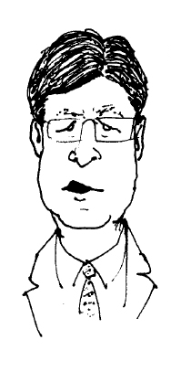
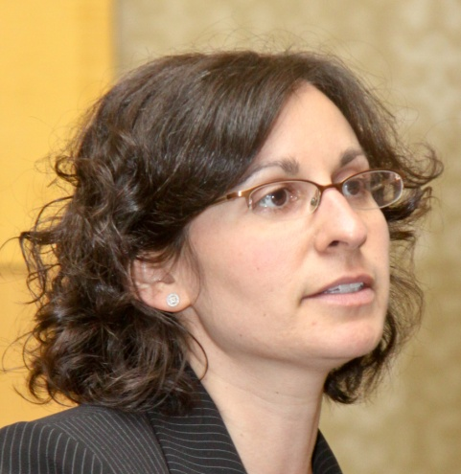
Principal NIMH Collaborators
Robert Heinssen
Susan Azrin
Amy Goldstein

Slide 7
Specified Aims of RAISE
Develop a comprehensive and integrated intervention to
Promote symptomatic recovery
Minimise disability
Maximise social, academic, and vocational functioning
Be capable of being delivered in real-world settings utilising current funding mechanisms
Assess the overall clinical impact and cost-effectiveness of the intervention as compared to currently prevailing treatment approaches
Conduct the comparison in non-academic, real-world community treatment settings in the United States

Slide 8
RAISE Trial Design: Subjects
Sample size: 404
Age 15-40
The following diagnoses are included in the differential
schizophreniform disorder
schizophrenia
schizoaffective disorder
psychotic disorder NOS
brief psychotic disorder
Less than six months of treatment with antipsychotic medications

Slide 9
Randomized Controlled Trial (RCT)
RCT to compare
NAVIGATE – experimental intervention
Community Care – treatment as offered in local clinics in the United States
Cluster/site randomization of 34 sites in 21 states
Two-year treatment period
Assessment model includes
On-site recruitment , engagement and retention
Remote assessors of primary and secondary clinical outcome

Slide 10
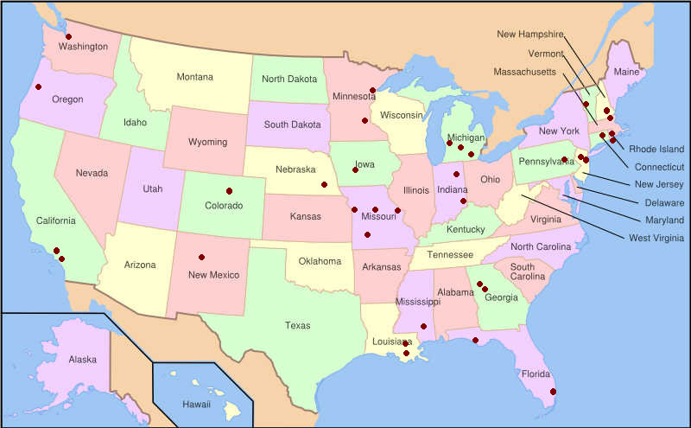
Conduct the Comparison in Non-academic, United States Community Treatment Settings ETP Sites are in 21 US Contiguous States

Slide 11
RAISE-ETP Study Design with Cluster/Site Randomization
RAISE – ETP
n = 404
NAVIGATE
17 sites
n = 223
17 sites
n = 181
COMMUNITY CARE

Slide 12
RAISE Trial: Outcomes
Primary outcome measure: Quality of Life scale
Primary hypothesis
RAISE intervention compared to community care will improve Quality of Life
Other measured outcomes
Service utilization
Cost
Consumer perception
Prevention of relapse
Enhanced recovery

Slide 13
Demographics Adjusted for Cluster Design
 | NAVIGATE | Community Care | p-value
Age and Gender
Age (mean) | 23.5 | 23.2
Males (%) | 77.6 | 66.2 | .05
Race
White (%) | 65.9 | 49.9
African American (%) | 25.4 | 44.1
Other (%) | 8.7 | 6.0
Role Functioning
In school (%) | 14.9 | 25.5 | .03
Working (%) | 12.6 | 16.6
Prior Hospitalization (%) | 76.2 | 81.6 | .05

Slide 14
Navigate
Team based
Shared decision-making
Strength & resiliency focus
Psychoeducational teaching skills
Motivational enhancement teaching skills
Collaboration with natural supports
Four components
Psychopharmacology – COMPASS
Individual Resiliency Training (IRT)
Family psychoeducation
Supported employment/education

Slide 15
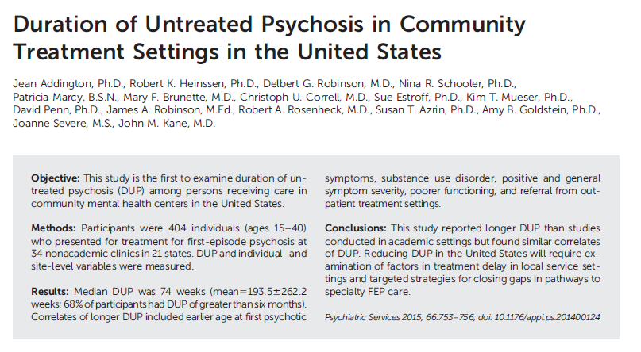

Slide 16
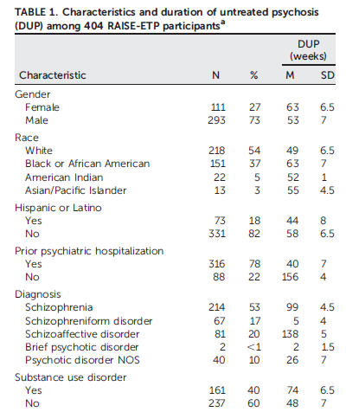

Slide 17
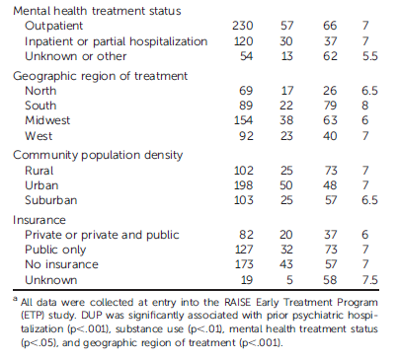

Slide 18
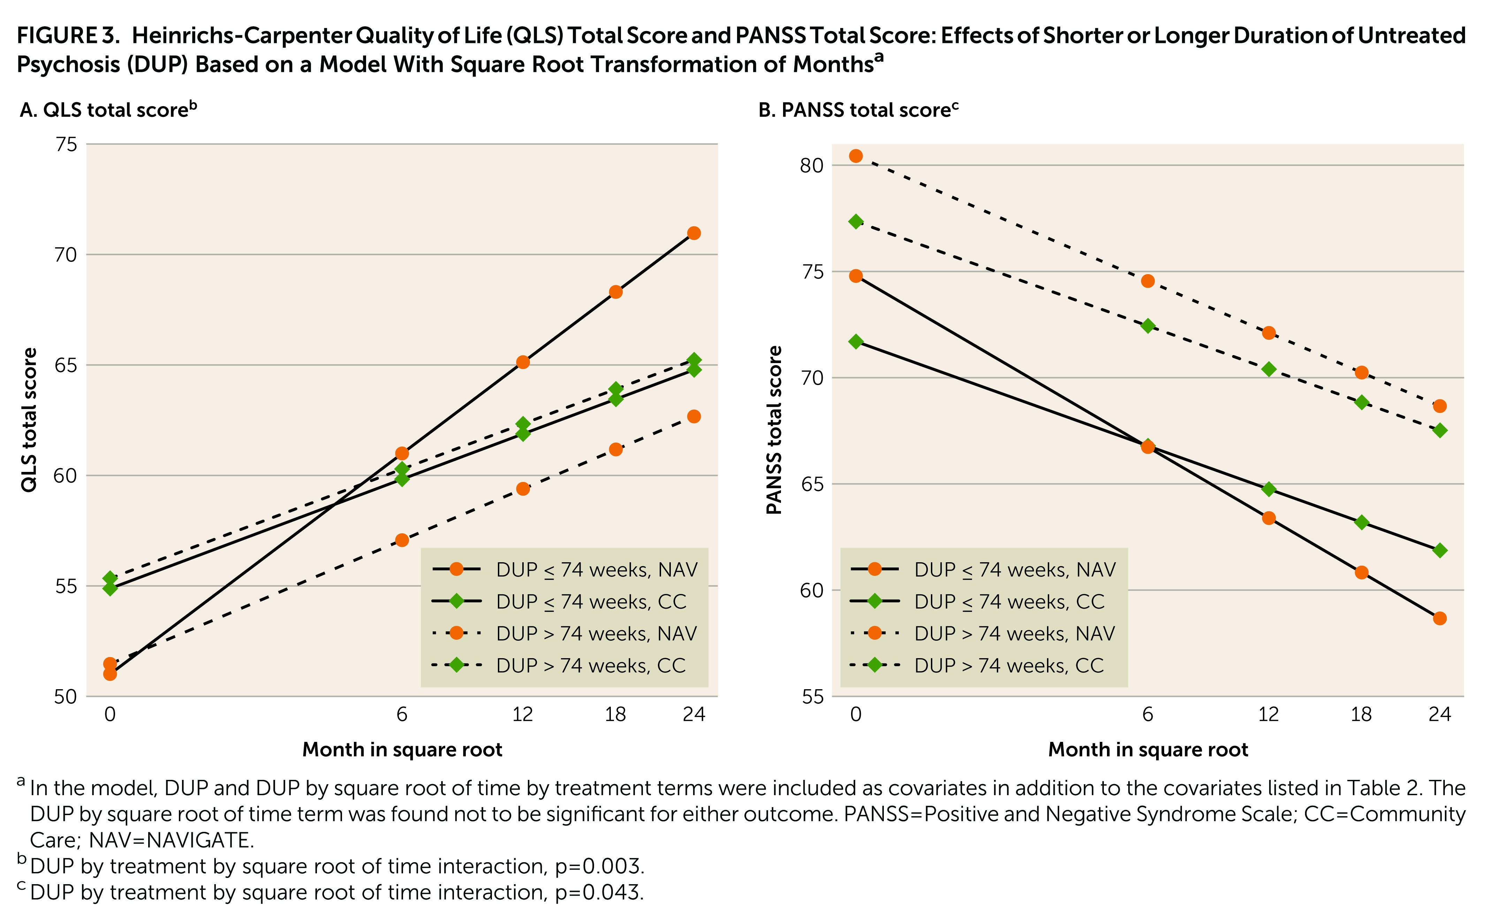
DUP and QLS and PANSS Outcomes
Kane JM et al. AJP 2016

Slide 19
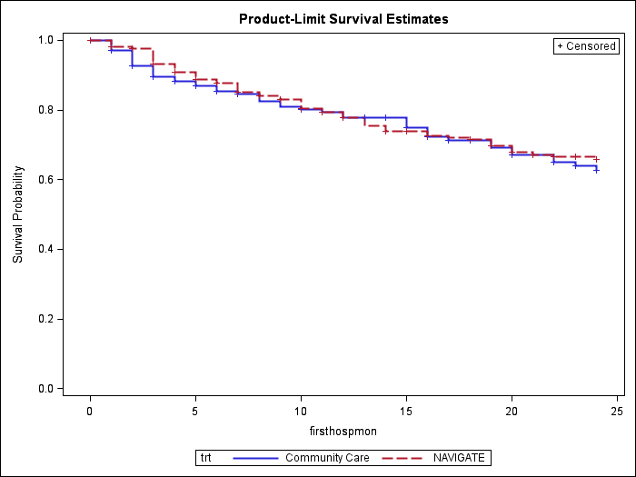
Time to First Psychiatric Hospitalization (Difference between treatments, p=0.75)
Notes:
Clustered log-rank test statistic = -0.53
p-value = 0.59
PH model for clustered data Chisq = 0.10
p-value = 0.75
Time to event
Median Months
Mean Months (SE)
Community Care
N/A
19.03 (0.66)
NAVIGATE
N/A
19.24 (0.55)

Slide 20
Multivariate Analyses of the Effect of Baseline Measures on Time to Hospitalization
DUP longer than 74 weeks (hazard ratio 1.5; 95% CI=1.0, 2.2)
Higher baseline scores on the PANSS excited factor (hazard ratio 1.09, 95% CI 1.0, 1.2)
Higher scores on the PANSS depression factor (hazard ratio 1.06, 95% CI. 1.0, 1.1)
In longitudinal analysis, compared to low risk non-adherence estimates
(assessed by the Adherence Estimator: McHorney, 2009) high risk non-adherence estimates significantly increased hospitalization risk HR 1.2 (CI 1.0-3.2)
Kane JM et al In preparation

Slide 21
Pathways to Care: Sample Questions
When did you first notice any concerning changes in your thoughts, feelings, or behaviors?
What did you think was causing these changes?
Where did you go to get answers?
Did your social media habits change? In what ways?
Did you ever discuss your concerns on social media?
Did you ever receive any advice on social media?
How would you feel if we at the Early Treatment Program used the internet or social media to reach out to you directly?

Slide 22
Pathways to Care
We interviewed 281 participants. 130 with psychosis, 35 with attenuated psychotic symptoms, 66 with non-psychotic mood disorders, and 50 healthy controls (58% male; mean age 21.5)
We also interviewed 67 parents (32 of PSY, 24 of APS, and 11 of Mood patients)
97% participants reported using social media.
Participants had used social media for the past 6.4 years, checked their social media sites 10 times a day (9 PSY, 9 APS, 16 Mood), spent 1.9 hours a day online (1.8, PSY, 1.8, APS, 2.5 Mood)
Facebook was reported as the most frequently used site by all participants followed by Instagram and Youtube.

Slide 23
Future Directions
Understand how youth are using the internet as means of obtaining information, communicating distress, seeking help, expressing psychotic thought content
Determine the impact of early and appropriate online educational material on help seeking behaviors in youth
Determine the impact of altering the social media experience of youth
Understand optimal strategies of using the internet and social media to connect with youth

Slide 24
Conclusions
DUP appears to be a moderator of the effects of coordinated specialty care on outcomes in FE schizophrenia in some populations.
However, DUP varies considerably in different settings and countries.
We need to better understand why this effect does occur in some subjects

