Slide 2
Rethinking DEI: From ‘nice to have’ to mission imperative
Monica L. Villalta
National Director Inclusion & Diversity Officer

Slide 3
Rethinking DEI: From ‘nice to have’ to mission imperative
Purpose:
Introduce myself
Rethinking the approach to DEI
Share selected definitions and emerging issues
Best Practices
What we are doing
Your voice

Slide 4
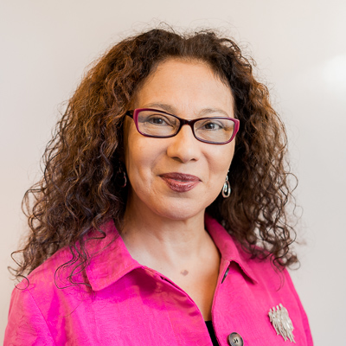
Immigrant
Bilingual/ESL
Pronouns: She/Her
First girl to complete university
Focus on cultural competence
Worked in health care systems, not-for-profit, volunteer management and research
AECF and NHLI Fellow
Not just a job.
A bit about my story

Slide 5
Achieving Mission

Slide 6
Stated and Aspirational Values

Slide 7
Executing on Strategy

Slide 8
Rethinking DEI

Slide 9
Some Basic Definitions
Diversity
Refers to all the similarities and differences
that define us as human beings
Notes:
TALKING POINTS
So that we are all on the same page with our terminology, I want to provide you with a very simple definition of what I mean when I am referring to diversity in this presentation.

Slide 10
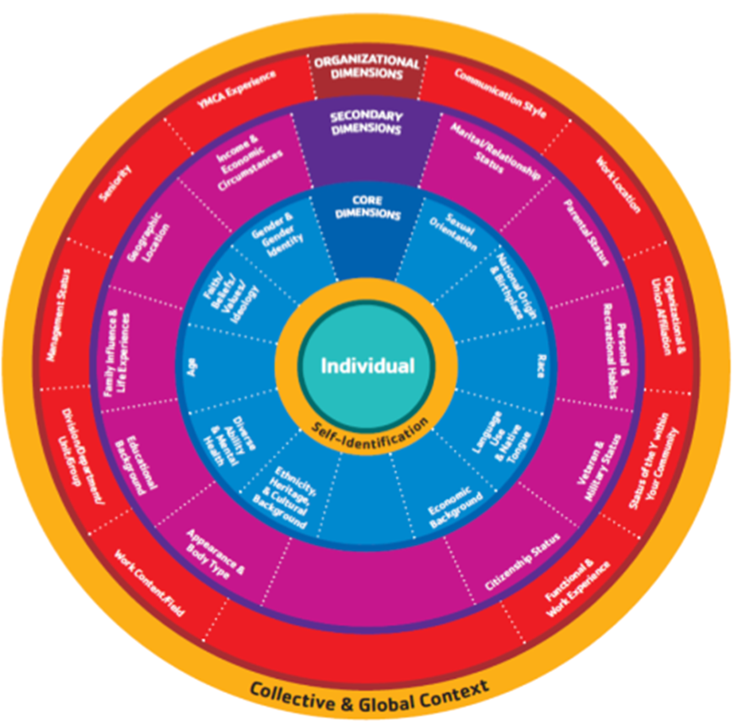
Diversity Dimensions

Slide 11
Dimensions of Diversity
The variety of differences and similarities/ dimensions among people, such as:
Age
Belief system
Class/caste
Culture
Disability
Education
Ethnicity
Gender
Gender identity
Generation
Geography
Job role and function
Language
Marital status
Mental health
Nationality
Native or indigenous origins
Parental status
Personality type
Race
Religion
Sexual orientation
Thinking style
Work experience
Work style
Notes:
There are three important definitions to know to fully understand Global Diversity and Inclusion Benchmarks: diversity, inclusion, and global.
• All three of these definitions were agreed to by the Expert Panelists (more on them later). You will find – literally – thousands of definitions of diversity and inclusion as well on the Internet. However, this definition has been agreed to by the Expert Panelists, so it is a pretty solid definition worth using.
• Diversity is the wide variety of differences and similarities – referred to as dimensions – among people.
• Listed here are some of the key dimensions.
We are sensitive that what the the various diversity dimensions are named may vary by geography, sector, or organization.

Slide 12
Definitions
Inclusion
The climate we create to help organizations and individuals benefit from diversity of ideas, knowledge and experience
Notes:
TALKING POINTS
If Diversity is the WHAT
Inclusion is the HOW

Slide 13
Inclusion is:
A sense of belonging.
Feeling respected, valued and seen for who we are as individuals.
There is a level of supportive energy and commitment from leaders, colleagues and others so that we —individually and collectively—can do our best work.
Source: Frederick A. Miller and Judith H. Katz. Copyright © 1991, 1995, 2007 The Kaleel Jamison Consulting Group, Inc.

Slide 14
Equity vs. Equality
● Diversity ≠ Inclusion
● Equity ≠ Equality

Slide 15
Culture
Source: Video Organizational Culture by Kathy Milhauser. 2014)
Notes:
ALKING POINTS
Cultural Competence refers to the individual or organizational capacity to effectively navigate across cultures
It is not a check list. It is an approach that includes skills, behaviors and attitudes.
Cultural and linguistic capacity are connected. Not one person can speak proficiently all languages.
Not one person can know and understand effectively ALL cultures. However, an individual can put into place
practices and policies that enable appropriate and effective cross cultural communication and services.

Slide 16
Culture
Culture
The set of beliefs, values, customs, actions, thoughts, communications, institutions, and ideas shared by social groups
Source: Video Organizational Culture by Kathy Milhauser. 2014)
Notes:
ALKING POINTS
Cultural Competence refers to the individual or organizational capacity to effectively navigate across cultures
It is not a check list. It is an approach that includes skills, behaviors and attitudes.
Cultural and linguistic capacity are connected. Not one person can speak proficiently all languages.
Not one person can know and understand effectively ALL cultures. However, an individual can put into place
practices and policies that enable appropriate and effective cross cultural communication and services.

Slide 17
Culture
Source: Video Organizational Culture by Kathy Milhauser. 2014)
Notes:
ALKING POINTS
Cultural Competence refers to the individual or organizational capacity to effectively navigate across cultures
It is not a check list. It is an approach that includes skills, behaviors and attitudes.
Cultural and linguistic capacity are connected. Not one person can speak proficiently all languages.
Not one person can know and understand effectively ALL cultures. However, an individual can put into place
practices and policies that enable appropriate and effective cross cultural communication and services.

Slide 18
Culture Clash

Slide 19
Culture Clash
Invisible History
Different experiences
Disparate treatment
Disparities & Disproportionalities in investments and outcomes
Injustice and unrest

Slide 20
“DEI are not ‘nice to have’. They are imperative to achieve mission” Monica Villalta
Rethinking the approach

Slide 21
Cultural Transformation
Diversity is leveraged to create a fair, healthy, and high performing alliance.
An inclusive environment ensures equitable access to resources and opportunities for all.
“When culture allows individuals and groups to feel safe, respected, engaged, motivated, and valued for who they are and for their contributions toward organizational or societal goals.”
Notes:
TALKING POINTS
If Diversity is the WHAT
Inclusion is the HOW

Slide 22
CULTURAL COMPETENCE
The capacity (including skills, behaviors and attitudes) to effectively and equitably navigate and interact across cultures
Notes:
TALKING POINTS
Cultural Competence refers to the individual or organizational capacity to effectively navigate across cultures
It is not a check list. It is an approach that includes skills, behaviors and attitudes.
Cultural and linguistic capacity are connected. Not one person can speak proficiently all languages.
Not one person can know and understand effectively ALL cultures. However, an individual can put into place
practices and policies that enable appropriate and effective cross cultural communication and services.

Slide 23
NOT
A fad
Affirmative Action /Compliance Requirement
Temporary Initiative
Reactive
YES
A mindset
The way we do our work (Behaviors, skills, attitudes)
Long Term Investment
A managed process
Notes:
TALKING POINTS
Often you will hear the term culture when we speak of Diversity. Though culture is part of diversity, these terms are not synonymous.
Culture is learned, and shared by members of a group while Diversity is descriptive

Slide 24
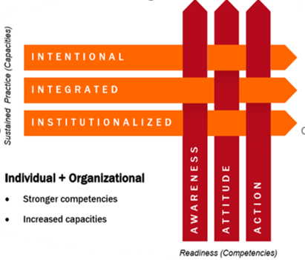
The right approach: Woven into organizational fabric

Slide 25
Why?

Slide 26
How?

Slide 27
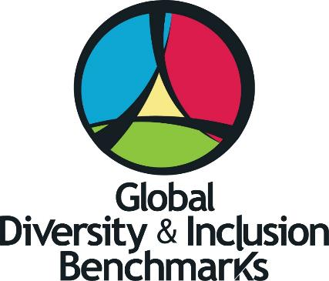
Best Practices: GDIB
Notes:
The logo is a stylized version of the new GDIB Model.
It is set in a circle to convey the ongoing and never-ending importance of diversity and inclusion.
The equilateral triangle in the center symbolizes equality and solidarity or strength and represents the Bridging Group.
Colors have a wide range of meaning across cultures. What may be interpreted as a positive meaning for one color in one culture may be a nearly opposite meaning in another culture. We have been thoughtful in our selection of colors and offer our interpretation, which is a combination of a various cultural symbolism. The color yellow was selected for Bridging because it stands for optimism and imagination. The green color for the Foundation Group symbolizes nature and renewal, blue for the Internal Group represents harmony and order, and red for the External Group stands for passion and strength. All are in a vibrant hue, which symbolizes the vitality to succeed.
The swirls of dark blue represent the power, energy, and motion needed to sustain this work.
And the openness of the swirls showing the colors overlapping one another symbolizes the integration and comprehensiveness needed for D&I to succeed.

Slide 28
The GDIB helps organizations
Realize the depth, breadth, and integrated scope of D&I practices
Assess the current state of DEI
Determine strategy and tactics
Measure progress in fostering inclusion and managing diversity
Notes:
Will use Global Diversity & Inclusion Benchmarks: Standards for Organizations Around the World (GDIB) to support organizations globally in the development and implementation of Diversity and Inclusion (D&I) best practices.
The GDIB helps organizations:
Realize the depth, breadth, and integrated scope of D&I practices;
Assess the current state of D&I;
Determine strategy, and;
Measure progress in managing diversity and fostering inclusion.
Diversity and Inclusion has emerged as a worldwide practice that is critical to an organization’s success. As with other disciplines, such as quality and safety, standards are needed to establish criteria by which to measure and monitor progress.

Slide 29
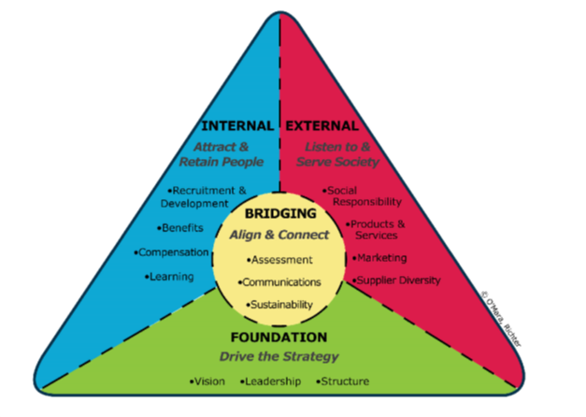
The Journey

Slide 30
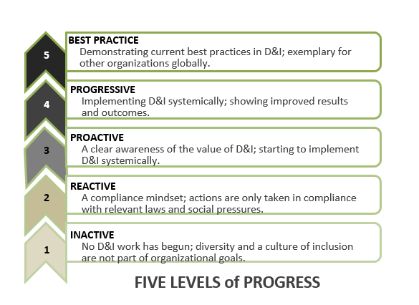
Measuring Progress

Slide 31
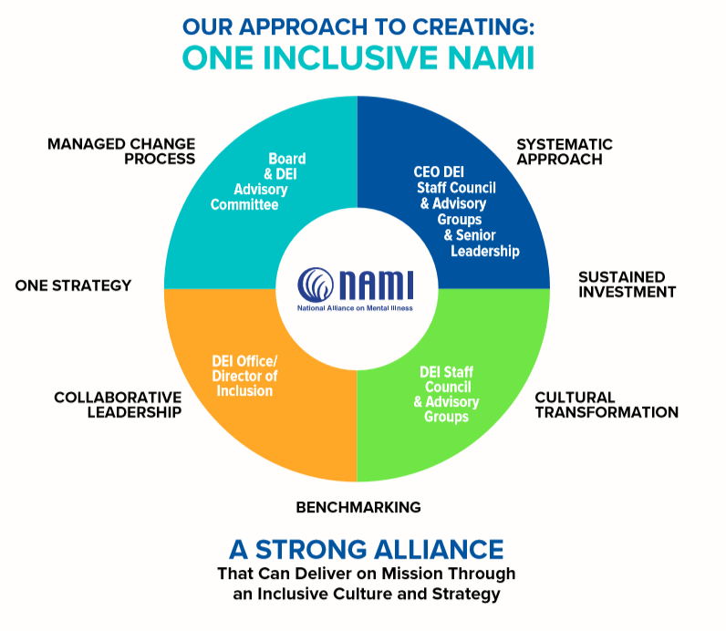

Slide 32
NAMI’s APPROACH
We are designing a strategic, comprehensive and systematic approach to cultural transformation. Efforts include:
• Building a solid foundation and an organizational structure that supports DEI.
• Defining diversity, equity and inclusion for our organization and using our shared language to advance our understanding.
• Assessing current status and planning for a desired future.
• Enabling training and development that enhances our capacity to interact effectively with colleagues and members of our surrounding communities.

Slide 33
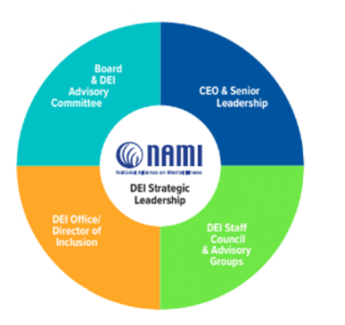
Leadership

Slide 36
A Framework for Operationalizing DEI
Career and People
Cultural Competence and how we Work
Communications and our Brand or Identity
Community/Clients and Growth

Slide 37
Stakeholder Voices

Slide 38
Your VOICE
The Alliance

Slide 39
Educational Resources on Racism and Inequality
Understanding the context of racism and recent events
Video on understanding racism and the reactions to the death of George Floyd and many others
Video on understanding the perspectives of your colleagues of color
Article on “White Privilege: Unpacking the Invisible Knapsack”
List of Anti-Racism resources
Understanding the context of racial inequality that impacts mental health
APA Best Practices on working with Black patients
APA Mental Health Facts for Black Americans (2017)
Ways to take action as an ally or champion for people of color
Article on being a white ally through word, actions and power
Article on being a white ally for racial justice
Community based organizations to partner with: Color of Change, Black Lives Matter, Change Zero, The Innocent Project

Slide 40
Thank You!

