Slide 1
Advocating for recommended clinical care when coverage is denied
Eric M. Plakun, MD
Andrew Gerber, MD, PhD
The Austen Riggs Center

Slide 2

The story of Susie
Susie is a 22 y/o woman
Parents divorced age 12
After this and bullying in grade school Susie struggles with depression
Susie goes to state college at age 18

Slide 3

Susie goes to State
Social anxiety, binge drinking and regular pot use
Traumatic date rape led to intrusive recollection of previous molestation by gymnastics coach at age 11 that she had tried to forget.
Depressed, trouble sleeping, poor concentration, suicidal ideation, developed bulimia to control her weight, symptoms of PTSD and marked social anxiety, stopped going to class and socializing, while continuing to use.
College counseling center offered 12 sessions with a therapist who focused on getting work done for classes.

Slide 4

Susie attempts suicide
Struggling and unable to cope, Susie overdoses in a suicide attempt, leading to 5 inpatient days, then left State College.
Outpatient treatment, unable to work, remained isolated—partly by choice, partly because friends away at school, binged and purged with weight loss, and SI continued. She insisted etoh and pot helped anxiety, and continued sporadic use.
Diagnosed with MDE in PDD—r/o bipolar, PTSD, BN, AUD, CUD, and SAD; treated with antidepressant, antianxiety agent and prazosin for flashbacks. After 20 sessions over 12 weeks her insurance company called the therapist to report 20 sessions made him an “outlier.”
“No further coverage if drinking continued”
“Pay for 6 more weekly sessions”
“Wanted a plan for reduction of therapy to monthly visits”
Reduction of therapy led to increased depression, another suicide attempt and second inpatient stay.

Slide 5

Referred to residential treatment
Longer inpatient stay recommended by inpatient and outpatient clinicians because of persistent SI and functional incapacity, but insurance declined coverage beyond 7 days. Referred to Residential Treatment Center, but insurance approved only PHP.
Expedited appeal noted the difference between 20 hours/week in PHP and immersion in 168 hour/week RTC
Denial of RTC was overturned, insurance supported 10 RTC days, then 7 more as Susie settled into the RTC program, began with RTC therapist and began family work. In individual and group therapy Susie began to grapple with underlying issues—not just SI and depression. As SI decreased, she began to socialize and leave her room more.
After 17 days insurance company said she no longer met criteria for acute RTC, offered 7 days of coverage for discharge planning, expecting discharge and return to weekly outpatient treatment.
Susie felt she had found what she needed to take charge of her life, but now it was being taken away.

Slide 6

Susie, her parents and her clinicians are left feeling

Slide 7
What’s going on here? 2 things are in conflict:
The nature of mental disorders
The nature of insurance coverage for them
Mental disorders are usually not discrete, single episodes of a single disorder
Often chronic, “comorbid” and recurrent
With acute problems superimposed on underlying issues related to early adversity
Tends to focus on the acute presenting problem
With an incentive to “kick the can down the road” because the average American stays with insurance plan for under 2 years

Slide 8

Incentive to “kick the can down the road” means Single Payer may be ultimate solution
What is the priority?
Lifetime health and wellness?
Minimizing “losses” for 2 years?

Slide 9

Let’s be clear: Managed care operates with the same moral imperative as the environmental movement
We face a world of resource limitation
Whether this is the amount of greenhouse gas the earth can absorb without manmade climate change
Or the costs of health insurance
We must recognize the problem and manage limited resources—legally, morally and ethically

Slide 10

The stable split of managed care utilization review since 1990s
The treating psychiatrist owes primary obligation to patient
The UR psychiatrist/clinician owes primary obligation to business
UR standards were developed as insurers saw fit.
Faced with a denial the unhappy choice is
  no care
  free care
  alternate funding

Slide 11

2008 Mental Health Parity and Addiction Equity Act (MHPAEA or parity law)
Barriers to access MH and SUD treatment cannot be more stringent than those for medical/surgical, including:
NO Quantitative Limits (QTLs) like lifetime dollars or days
NO Non-Quantitative Limits (NQTLs) like UR hurdles

Slide 12

Affordable Care Act strengthens parity
MH and SUD treatment part of essential benefit package
Reinforces parity
Disclosed UR guidelines
BUT minimal enforcement of QTLs and NQTLs because
Gov’t needed alliance with insurance industry for ACA exchanges

Slide 13

Parity enforcement unlikely to be
“top down,” so it is “bottom up”
Trump administration? “Repeal and Replace. No never mind. Well, maybe, but it’s a secret.”
1--Class action lawsuits against large insurers
2--Does recent clarification of psychiatric ethics change the landscape under parity law?

Slide 14

3 things to have in your tool kit when faced with denial of medically necessary services
Use your voice as party to a legally binding contract to provide care
Anchor your appeal to third party resources
Invoke the parity law to question the legality and/or ethics of UR standards that suggest QTLs or NQTLs

Slide 15

Use your voice as party to a legally binding contract
Read your contract
50% have ERISA (employer) insurance
Does it offer medically necessary care within generally accepted standards?
Follow up with agent, insurance grievance process, ombudsperson, lawyer, state insurance review boards
Document contacts, hold times, recurrent phone loops

Slide 16

Anchor your appeal to third party resources
Several instruments have been developed to facilitate level of care assignments using objective methodology
One is the Level of Care Utilization System (LOCUS and CALOCUS) developed by the American Association of Community Psychiatrists (AACP)
Intentionally conservative and cautious

Slide 17
3 Objectives of LOCUS
Defines 6 dimensions (safety, functional capacity, response to previous treatment, strengths, etc.) for assessing level of care needs
Describes levels of care from outpatient through inpatient hospitalization
Offers quantitative methodology to rate appropriate level of care based on total score across all 6 parameters or override scores

Slide 18

Anchor your appeal to third party resources
Clinical Practice Guidelines focus on more than acute presenting problem
Often address phases of treatment for a disorder over time
However, may not address “comorbidity”

Slide 19

Anchor your appeal to scientific research
Your clinician should be a resource in knowing relevant research
Be wary of insurance companies that “cherry pick” the data
Be wary of biases in the field
Treatment research by single disorder, but >75% are “comorbid”

Slide 20
Does the parity law raise questions about the UR standards (QTLs or NQTLs) based on comparable situations in medical coverage?
Susie’s mental disorder
Compared to medical illness
No more coverage unless she stops drinking
No coverage for nutritional counseling for eating disorder
Exclude RTC except as alternative to brief acute hospital—inpt or outpt
Covers diabetic not following diet
Covers nutritional counseling for diabetes
Covers intermediate level of care for stroke pt who cannot walk, talk or dress herself

Slide 21
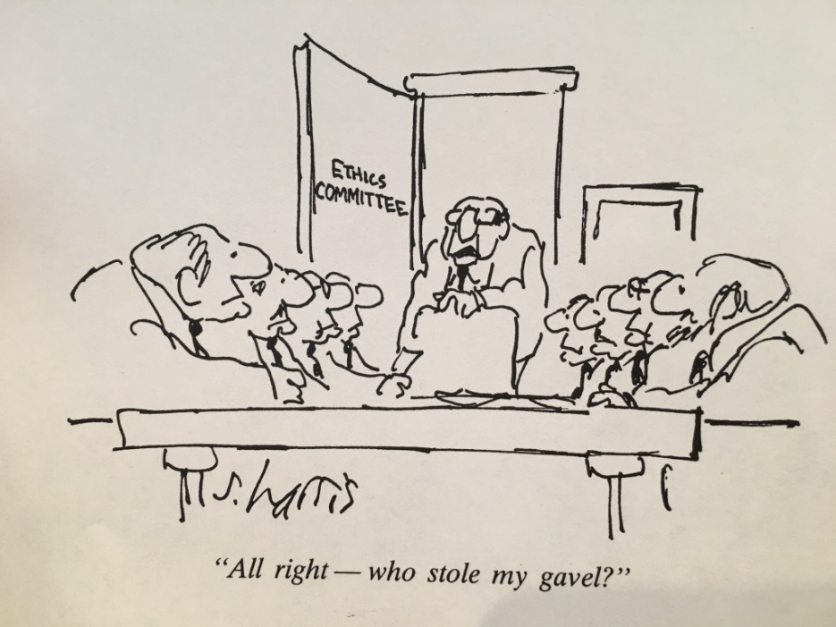
Ethical obligations of Managed Care Psychiatrists

Slide 22
As physicians, psychiatrists’ ethics are governed by 2 relevant ethical codes
The Principles of Medical Ethics of the American Medical Association, last revised in 2016
The Principles of Medical Ethics With Annotations Especially Applicable to Psychiatry
In 2015 these were summarized in an APA document entitled Commentary on Ethics in Practice

Slide 23
APA Commentary on Ethics in Practice, 2015
Developed by Ad Hoc Work Group based on Principles of Medical Ethics With Annotations Especially Applicable to Psychiatry (psychiatry’s ethical code)
Practical guidance for managing ethical dilemmas in day-to-day practice.
Topic 3.4.1 “Working within organized systems of care,” including “third party payors”
“In these systems, other values often compete with the interests of the individual patient. The fundamental tension of psychiatrists working in organized settings, then, is that the terms of employment relate to the needs of the venture, but as physicians, psychiatrists working in organized systems of care cannot wholly ignore the needs of patients.”

Slide 24
Principles of Medical Ethics of the AMA, 2016. Section 10.1.1 Ethical Obligations of Medical Directors https://www.ama-assn.org/sites/default/files/media-browser/code-of-medical-ethics-chapter-10.pdf.
Physicians’ core professional obligations include . . . advocating for patients’ best interests.
When physicians accept the role of medical director and must make benefit coverage determinations on behalf of health plans or other third parties or determinations about individuals’ fitness to engage in an activity or need for medical care, they should:
(a) Use their professional expertise to help craft plan guidelines to ensure that all enrollees receive fair, equal consideration.
(b) Review plan policies and guidelines to ensure that decision-making mechanisms:
(i) are objective, flexible, and consistent;
(ii) rest on appropriate criteria for allocating medical resources in accordance with ethics guidance.
(c) Apply plan policies and guidelines evenhandedly to all patients.
(d) Encourage third-party payers to provide needed medical services to all plan enrollees and to promote access to services by the community at large.
(e) Put patient interests over personal interests (financial or other) created by the nonclinical role.

Slide 25

Patient’s needs not just the clinician’s obligation any more
Undoes the stable split
UR psychiatrist has obligation to patient . . . and parity law
AKA “Skin in the game”
Working within the APA to take a clear stand on this issue

Slide 26

What about Susie?
Parents complained to employer and policy sales agent
Appeal letter cited research
Appeal letter noted Susie’s LOCUS score indicated residential treatment
You win some and lose some
Court precedents will matter

Slide 27

Take home message: For a patient, family member, advocate or provider faced with denial of care
Use your voice as party to a legally binding contract to provide care
Anchor your appeal to third party resources like LOCUS, research and Practice Guidelines
Expect reviewers to follow the parity law and to use UR standards that comply with section 3.4.1 of the APA Commentary on Ethics in Practice and chapter 10.1.1 of the AMA Principles of Medical Ethics

Slide 28

Thank you. Interested in more? Join us in Stockbridge September 23

