Slide 1

Honest, Open, Proud to Erase the Stigma of Mental Illness
Kyra Newman, MSW
Director of Recovery
NAMI Chicago

Slide 2

NAMI Chicago
The mission of the National Alliance on Mental Illness (NAMI) Chicago is to provide hope and improve the quality of life for those whose lives are affected by mental illness, by providing information and referrals, education, support, advocacy, and active community outreach.

Slide 3
Stigma
What is stigma?
  Negative stereotypes, labels, judgments and prejudice that can lead to discrimination.
  Stereotypes: Generalized belief; “People with mental illness are violent”
  Prejudice: Judgment based on that belief; “They’re violent, I’m scared and don’t want anything to do with them”
  Discrimination: Action based off those judgments and beliefs; “I won’t hire or rent to a person with mental illness because I’m scared of them”

Slide 4


Slide 5


Slide 6


Slide 7


The movies…

Slide 8


The newspapers…

Slide 9


In advertising…

Slide 10
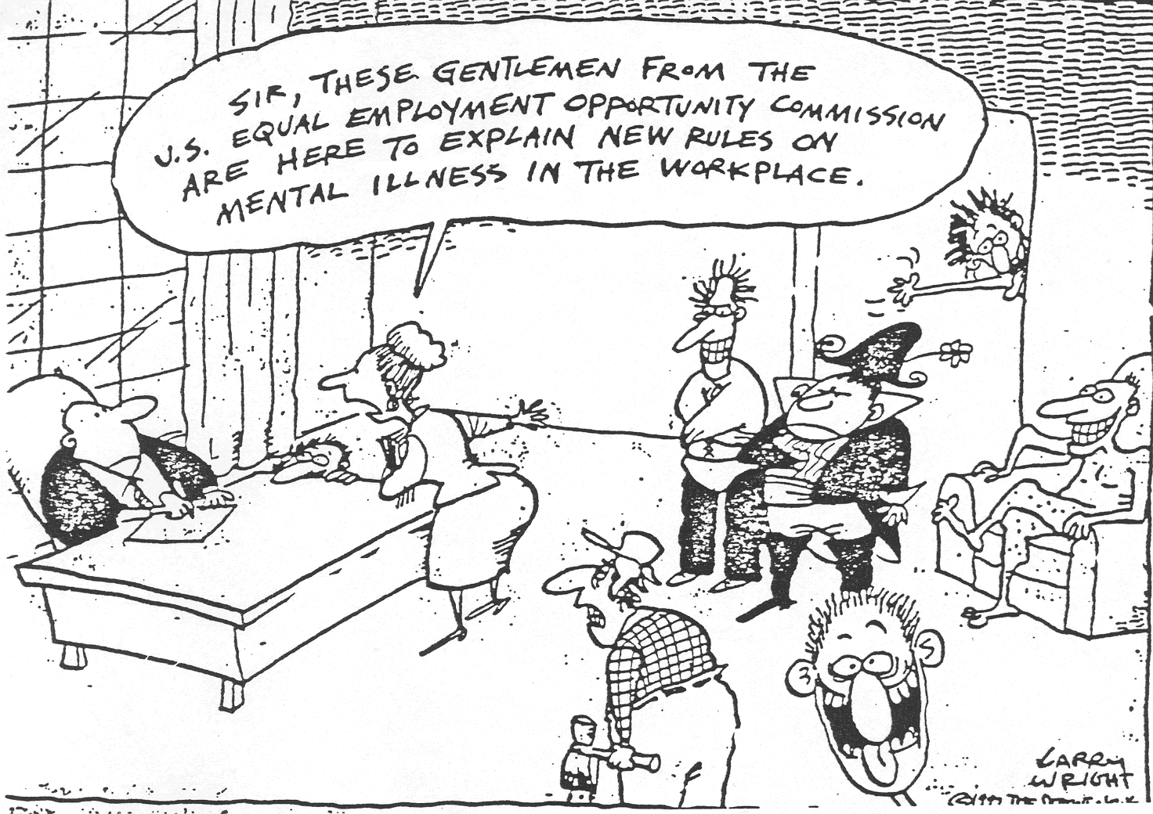
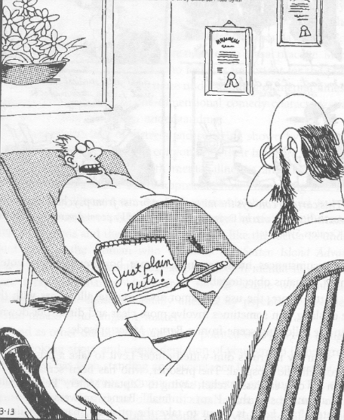
In comics…

Slide 11

Hasn’t it gotten better?
July 10, 2002: Trenton State Hospital (NJ) has a fire…

Slide 12
Types of stigma
Public stigma: Stigma faced externally from a system, group or individual
Public stigma effects many areas of life:
  Employment
  Housing
  Healthcare
  Education

Slide 13
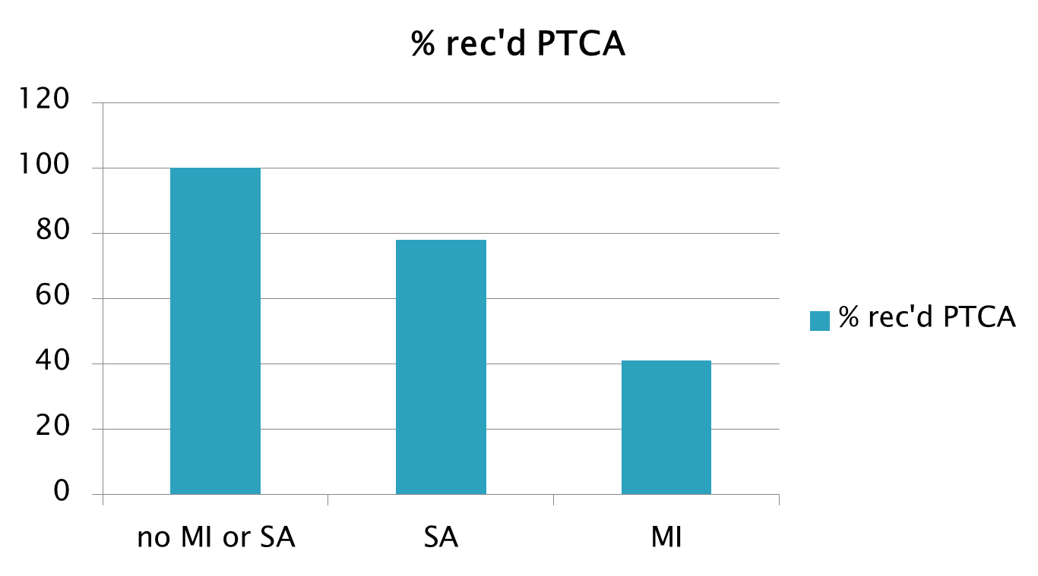
Effect on Healthcare
PTCA: percutaneous transluminal coronary angioplasty Druss et al., 2000

Slide 14
Types of stigma
  Self-stigma: internalized public beliefs that effect self-esteem and self-efficacy
    I’m not worthy, I’m not able
    “Why try?” Effect
    Diminished care seeking & treatment engagement; people do not want to be seen as one of “those” people so they aren’t likely to seek mental health services
    Worse outcomes for recovery

Slide 15
What can we do?
  Individual level
  Affirming attitudes:
    People with mental illness recover
    They should determine all their goals and interventions to reach those goals
  Actions and Advocacy:
    Reasonable accommodations
    Community Supports
  Easy stuff: CHANGE YOUR WORDS
    Use first person language
    Avoid stigmatizing teram and call out other people who use them

Slide 16
What can we do?
  3 main strategies to decrease sigma at an organizational level:
  Education
  Protest
  Contact

Slide 17

Education
Lets learn from the past…
Education: There is no strong evidence to suggest that public education campaigns have any effect on stigma and behavioral changes
75% of US School Districts
43 countries used DARE
How did it go?

Slide 18
Research on Dare
Uncertain effects
  RTI (1994)
No effects
  Cal Dept Ed (1995)
  U Maryland (1998)
  APA (1999)
Worse effects
  Indiana U (1992)

Slide 19

The Decade of the Brain
NIH/NIMH Initiative from 1990-2000
Promoted idea that mental illness was a brain disease rather than a character flaw
Spurred neurological research into causes and cures
Unintended consequences:
  Belief that recovery was not possible
  Diminished acceptance of people living with metal illness as a result
  Schomerus, Schwann, Holzinger, Corrigan, Grabe,
  Carta, & Angermeyer, 2011

Slide 20


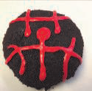
Protest
Review stigmatizing images & protest them
Call people out & demand change
“Shame on you for thinking that way”
Beware “the white bear” phenomenon
“The Crazy Face”
Psycho Donuts now has FRANCHISE OPPORTUNITIES!
“The Suicide SQUEEZE”

Slide 21
Contact
Meet someone!
“Hi, my name is Kyra and I live with mental illness”
Challenges stereotypes
Research has shown regular contact with people with lived experiences has the strongest and longest lasting effect on stigma

Slide 22
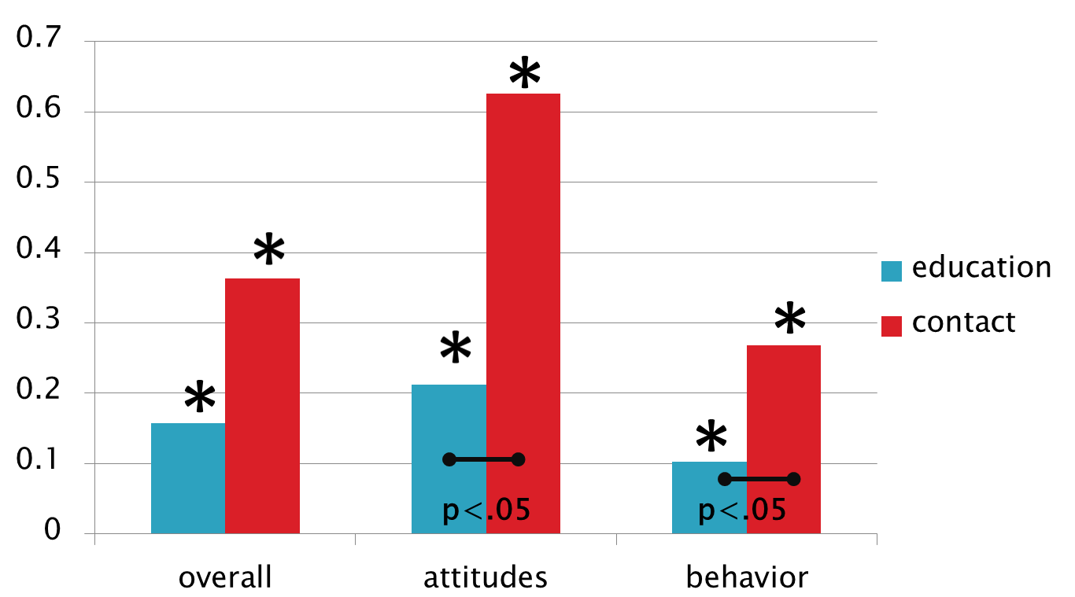
Contact & Research
Meta-analysis: 79 studies; 13 RCTs
Mean effect sizes: RCTs only
Corrigan, Michaels et al., 2012

Slide 23
TLC 3 Approach
Targeted
  Landlords, teachers, healthcare professionals, employers
Local
  Culturally appropriate and as local as possible (city, office, church, etc.)
Credible
  Veterans to veterans, etc.
Continuous
  Once is not enough
Contact!
  Which means disclosure!

Slide 24
TLC 3 Approach: Organizations
Engage with individuals living in recovery!
Utilize peers in mental health services, education and advocacy
  Share their stories in the community as a part of education programs
  Participate and lead programs and workshops
  Provide leadership opportunities in your organization
  Peers are the experts on their own experience, and are the most qualified to speak about mental health recovery.

Slide 25
TLC 3 Approach: Individuals
  Share your story of recovery in the community, with friends and family!
  Listen to each other and give people a platform to use their voices!

Slide 26
Honest, Open, Proud Program
  Developed by Dr. Corrigan at the Illinois Institute of Technology (IIT) with peers input
  Anti-stigma program focused around the concept of self-disclosure and the complex decision making process that surrounds it
  Peer led
  6 hour workshop conducted in a group setting with 8-15 peers
  The goal of HOP is not to convince people to come out and share their stories, but rather to teach skills and strategies so they can make the best decisions for themselves.

Slide 27
Honest, Open, Proud Program
  Lesson One
    Language and Identity
    Considering the Pros & Cons of Self Disclosure
  Lesson Two
    Five ways to disclose (or not to disclose)
    Strategies to test someone out
    Consider what characteristics might make someone safe or good to disclose to
  Lesson Three
    Learn how to share your story in a personally meaningful way and practice saying it out loud
    Learn about peer support and how it can help you in your recovery
    Put it all together and move forward!

Slide 28
Multiple Version of HOP
HOP for Anyone
HOP for College Campus
HOP for High School Students
HOP for Veterans and Veterans Health Administration
HOP for people who are currently incarcerated
www.hopprogram.org
www.comingoutproudprogram.org

Slide 29
HOP Development and Research
2 Randomized control trials of the HOP Program have been conducted so far
The results are clear:
  Significant reduction in stigma stress, including aspects of self-stigma and improved self-esteem
  Less distress at the idea of disclosing their mental illness experience
  Perceived less need to keep their identity a secret after completing the program

Slide 30
Learn more about stigma & HOP!
National Consortium on Stigma and Empowerment
http://www.stigmaandempowerment.org/
Honest, Open, Proud Program Website
http://www.honestopenproud.org

Slide 31
Questions?
Kyra Newman, MSW
312-563-0445
kyra@namichicago.org

