Slide 1


Hill Day Meeting Prep

Slide 2


Today’s Session
Why your advocacy is important
What to expect on Capitol Hill
Mechanics of a legislative meeting
Tips for an effective meeting
Telling your story
Follow-up and next steps
Notes:
Military and veterans’ mental health
Mental health family caregivers
Early intervention for psychosis
Decriminalizing mental illness
Research and innovation

Slide 3

Hill Day Guide
Schedule for Hill Day
Tips for meeting with your legislator
Getting around Capitol Hill
Introducing NAMI to your legislator
Talking points and asks
Follow-up steps
Social media tips

Slide 4
Why Advocate?
Because everyone with a mental health condition deserves the opportunity for recovery
Notes:
Advocacy is a core element of NAMI.
While everyone with a mental health condition deserves the opportunity for recovery, many don’t get the care that they need.
Without mental health care, America pays a high price in:
-School failure
-Unemployment
-Homelessness
-Criminalization
-Suicide

Slide 5
Yet, many who could be helped don’t get the care they need.
Without quality, affordable mental health care, America pays a high price in:
    School failure
    Unemployment
    Homelessness
    Criminalization
    Suicide
Notes:
Advocacy is a core element of NAMI.
While everyone with a mental health condition deserves the opportunity for recovery, many don’t get the care that they need.
Without mental health care, America pays a high price in:
-School failure
-Unemployment
-Homelessness
-Criminalization
-Suicide

Slide 6


Why Advocate?
Politics is personal
  Legislators serve their constituents
  Legislators respond best to people they know
Legislators vote on laws and budget that determine who can get…
  What care
  For how long
  At what cost
Notes:
Senators and Representatives are elected to serve as the voice of their constituents in Congress. They are responsible to their constituents because what they do, say and how they vote impact constituents’ lives. In between elections, American citizens have the right to voice their opinion and tell legislators how they want their elected officials to vote and hold them accountable to the people to whom they serve.
But politics is extremely personal.
Legislators cannot help our communities if they don’t know about our issues and why they matter.
Meetings with legislators puts a face on mental illness, which helps build support for our issues. As they decide on the issues that impact our community, legislators need to hear from our advocates about the impact of their decisions.
Effective meetings leave legislators and their staff with a greater connection to NAMI and a better understanding of what legislation will do to people with mental illness.

Slide 7

Why Advocate?
You have a story to tell.
Real stories change hearts and minds…
…and build support for mental health.
Notes:
Empowering advocates to speak directly to their members of Congress is important to change minds about mental illness and reduce the stigma around mental health.
Advocates can be people with mental health conditions, family members, mental health professionals and other allies.
When advocates deliver an effective story and share supporting facts about the impact of legislation, they can change the outcome of legislative decisions.
This is more important now than ever, as health reform threatens access to mental health care and budget cuts could jeopardize important progress that has been made on key areas, such as research, criminal justice reform and early intervention for psychosis.

Slide 8

What to Expect on Capitol Hill
Notes:
Empowering advocates to speak directly to their members of Congress is important to change minds about mental illness and reduce the stigma around mental health.
Advocates can be people with mental health conditions, family members, mental health professionals and other allies.
When advocates deliver an effective story and share supporting facts about the impact of legislation, they can change the outcome of legislative decisions.
This is more important now than ever, as health reform threatens access to mental health care and budget cuts could jeopardize important progress that has been made on key areas, such as research, criminal justice reform and early intervention for psychosis.

Slide 9





Hill Day Materials
Leave behind materials
Legislator Backgrounders
Hill Day Guide
Notes:
Make reminder about leave behind folders:
1 green folder per legislator meeting
These folders will be given to the volunteer assigned to your state.
Folders will be distributed tomorrow morning at the legislative plenary session.
Each attendee should have a Hill Day Guide in front of them (available on their tables).
Also on your tables are legislative backgrounders with legislator bios and additional information, which we’ll review a little later.

Slide 10
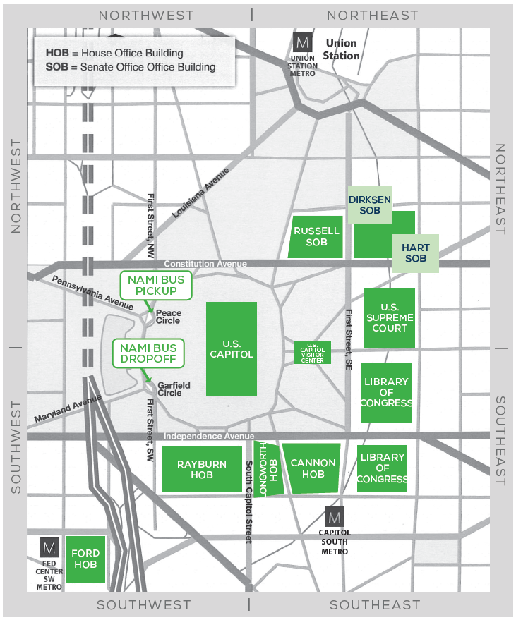
Getting To Capitol Hill
See page 2-3 of Hill Day Guide.
Two waves of buses:
9 AM
11 AM
Stay with your state delegation and your state volunteer
(in the green shirt).

Slide 11
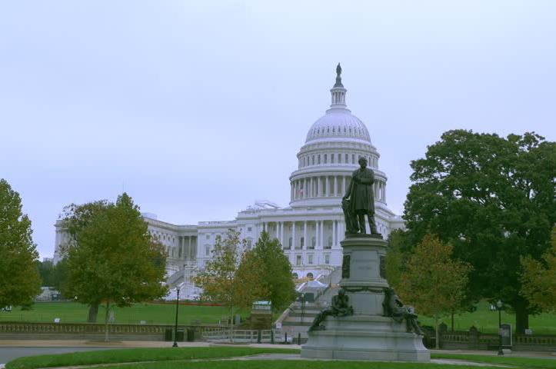
Getting To Capitol Hill
Drop-off point:
Garfield Circle, SW
This is a 5-10 minute walk to all Senate and House office buildings.

Slide 12
Getting To Capitol Hill

Slide 13
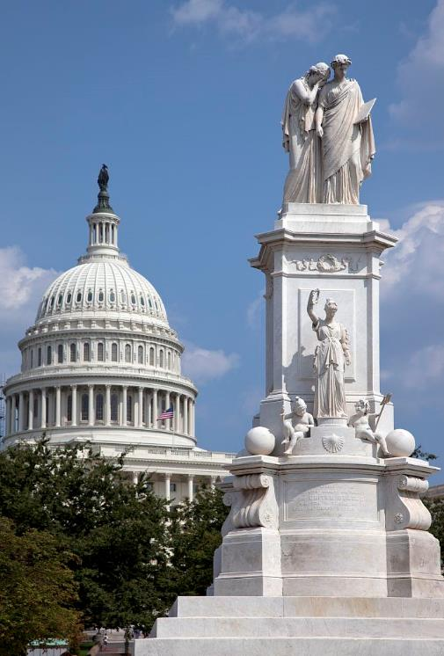
Getting Back From Capitol Hill
Pick-up point:
Peace Circle, NW
(adjacent to drop off point)
Pick-up starts at 12:30 p.m.
Continuous loop to hotel
Last pick-up is 3:30 p.m.
(See alternative return options on page 3 of Hill Day Guide.)

Slide 14
Getting Back From Capitol Hill
Pick-up point
Drop-off point

Slide 15
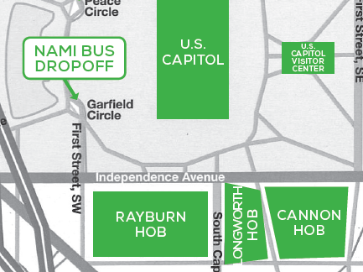
House Office Buildings
Rayburn
Longworth
  *Office #1223 would be on the 2nd floor
Cannon
  *Office #327 would be on 3rd floor

Slide 16
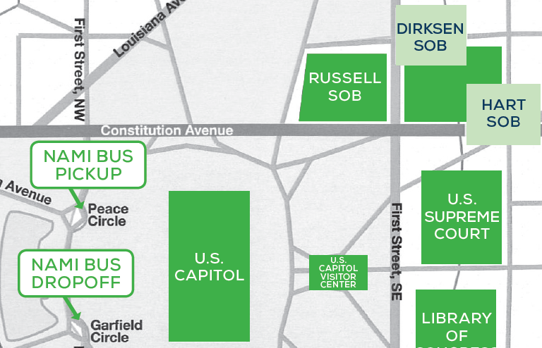
Senate Office Buildings
Russell
Dirksen
Hart
  *Office #204 would be on the 2nd floor

Slide 17

Capitol Hill Security
Items Not Allowed:
          Weapons
          Sharp objects
          Aerosol containers
          Non-aerosol sprays
          (except for prescriptions)
          Sealed envelopes or packages
The Capitol Visitors’ Center does not allow
outside food or beverage.

Slide 18
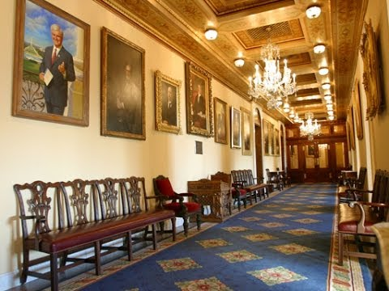

What to Expect in Hill Offices
MYTH

Slide 19
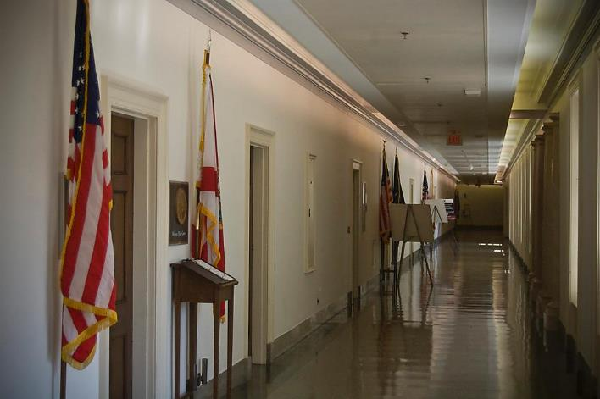
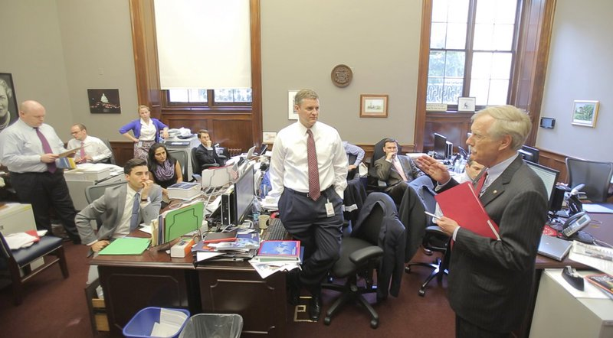
What to Expect in Hill Offices
REALITY

Slide 20
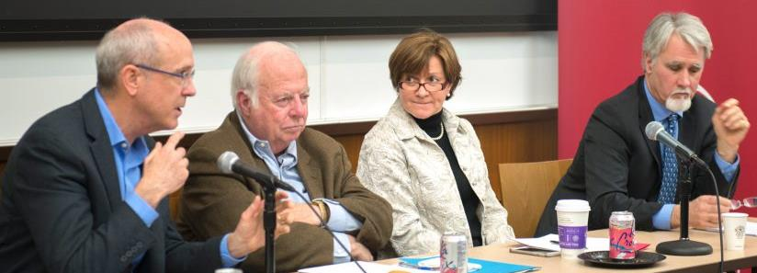
What to Expect in Hill Offices
MYTH

Slide 21
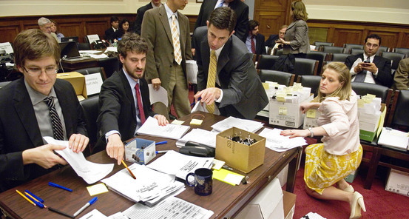
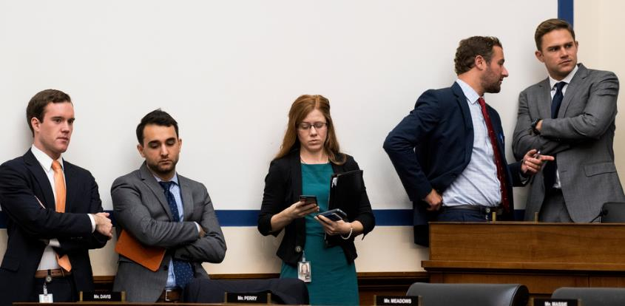
What to Expect in Hill Offices
REALITY

Slide 22
What to Expect in Your Meetings

Slide 23

Meeting Format
Make valuable use
of limited time.
Expect 15 minutes.

Slide 24
Meeting Format
Step #1: Introduce NAMI
Step #2: Share a personal story
Step #3: Discuss key asks and
additional priority issues
(as time allows)

Slide 25
Sample Meeting

Slide 26
General Tips for an
Effective Meeting

Slide 27
Meeting Tip #1
Facts support.
Stories move.

Slide 28
Meeting Tip #2
Use first-person
language.

Slide 29
Meeting Tip #3
Make the ask.

Slide 30
Meeting Tip #4
Nudge…
don’t push.

Slide 31
Meeting Tip #5
Expect some
resistance.

Slide 32
Building a Connection with Your Legislator

Slide 33
Connecting with Legislators
Be respectful
Remember that NAMI takes positions on bills, not people or politics
Look for ways to connect and build a relationship

Slide 34
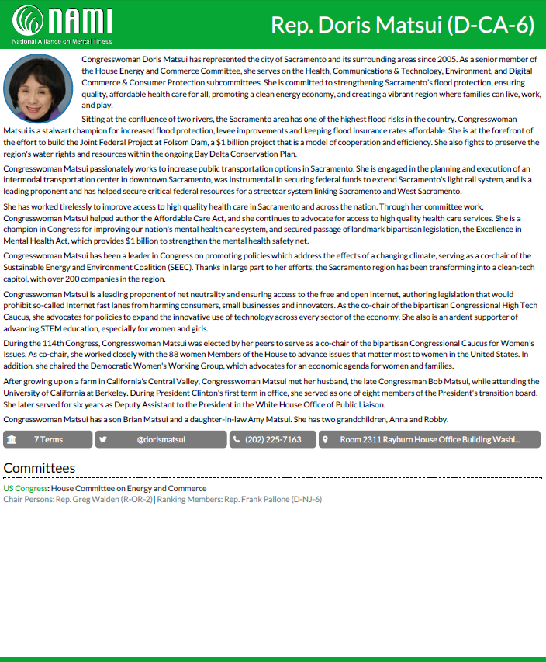
Legislator Backgrounders
Party and district information
Biography
Number of terms/
social media information
Committees

Slide 35
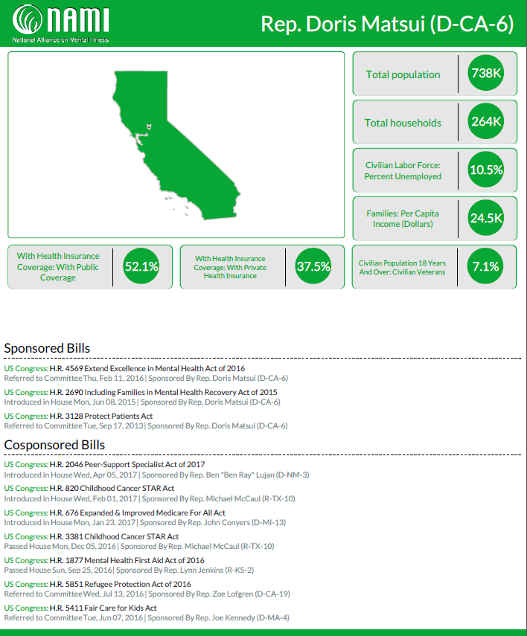
Legislator Backgrounders
District details and stats
Sponsorship/
Cosponsorship information

Slide 36
Telling Your Story

Slide 37
Story Tip #1
Keep your story brief –
just the highlights.

Slide 38
Story Tip #2
Paint the picture with
vivid language.

Slide 39
Story Tip #3
Motivate with hope
and recovery.

Slide 40
Story Tip #4
Follow with an ask.

Slide 41
Write Your Own Story
Use your “Story Practice Sheet.”

Slide 42
Practice Sharing Your Story
Turn to your neighbor
Take turns telling your stories
(90 seconds or less)
Give and receive constructive feedback: What’s one thing that would make the story even better?

Slide 43

Assign Meeting Roles
Meeting lead
Storyteller
Messenger

Slide 44
Follow-up and Next Steps

Slide 45
Close on a Positive Note
Express thanks
Review leave behind materials
Offer to be a resource on
mental health issues
Make a request or invitation
(e.g., NAMIWalks event)

Slide 46

After Your Meeting
Send a thank you email
Share photos and thanks on social media
Fill out a feedback home
Keep the conversation going at home

Slide 47
After Your Meeting
Sign up for advocacy alerts at:
www.nami.org/advocacy

Slide 48
Questions?

